Slide 1
MORTGAGE DEFAULT RISK
& FRAUD DETECTION

Slide 2
Reading Assignments
“How to Determine the Best Model”

Slide 3
Money & Banking System

Slide 4
How Do Banks Make Profit?
interest
interest

Slide 5
Mortgage Default
Loan approval is one of the most important functions of these financial institutions. For most banks, loans form a half or more of their total asset and about 1/2 up to 2/3 of their incomes.
Bad loans: debtors who can not fulfill the obligations
Asymmetric information: a borrower may have known his/her financial risk but the lender does not know.
A probability of default (PD) – The probability that a debtor will not fulfil its obligations.

Slide 6
Healthy Business Model
Lend to borrowers who will honor the contract and is able to re-pay the debt
Do not lend to borrowers who cannot
Avoid any fraud

Slide 7


Model Design - What is the purpose of a model?
What’s today?
??
Day 1
Day X
What we want?
Educated guess
Day 1
Day X
Always think about the timing of the variables

Slide 8
Model Design - What is the purpose of a model?
What we want?
Educated guess
Day 1
Day X
Always think about the timing of the variables
X
Y
Xs are the variables known on Day 1
Y is the outcome that we want to know

Slide 9
Let’s use this basic form to think of a modeling dataset
How to build a modeling dataset?
Y
+
X
Build a modeling dataset that uses Y, the later information, with Xs, the information on Day 1.

Slide 10
Model Design - What is the purpose of a model?
X
Y
But also remember:
Usually your Xs cannot give you prefect prediction.
Xs are the variables known on Day 1
Y is the outcome that we want to know
Your predictors can put the suspects to certain groups, but usually cannot predict which particular one is the suspect.

Slide 11
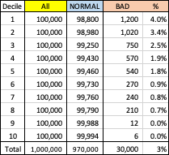
Use a Gains Table to Validate the Model
Suppose there are 1,000,000 loans you don’t know them on Day 1 which one is fraudulent.
Suppose the cost to review a case for further investigation is 20 hours.
More fraudulent cases
Y
More normal cases

Slide 12
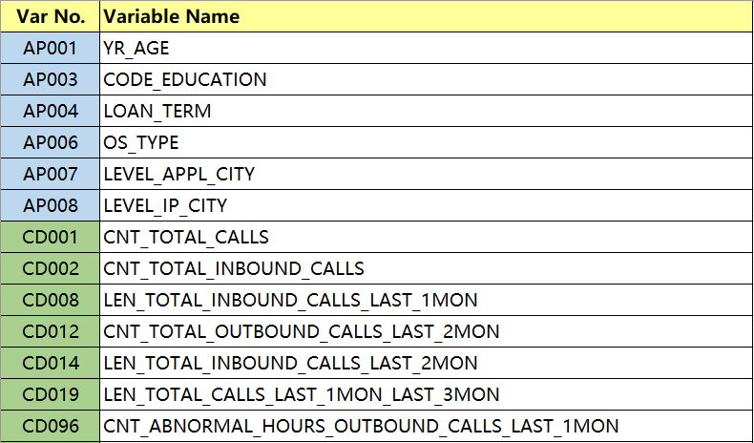
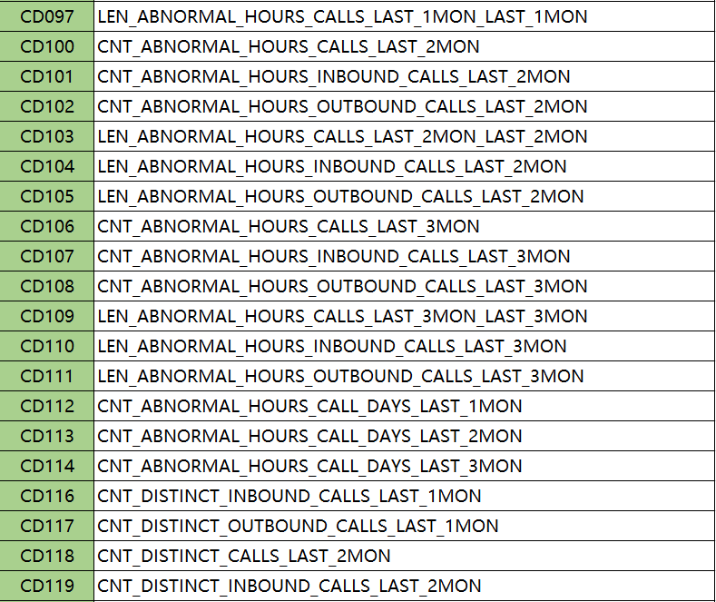
Variable Names

Slide 13
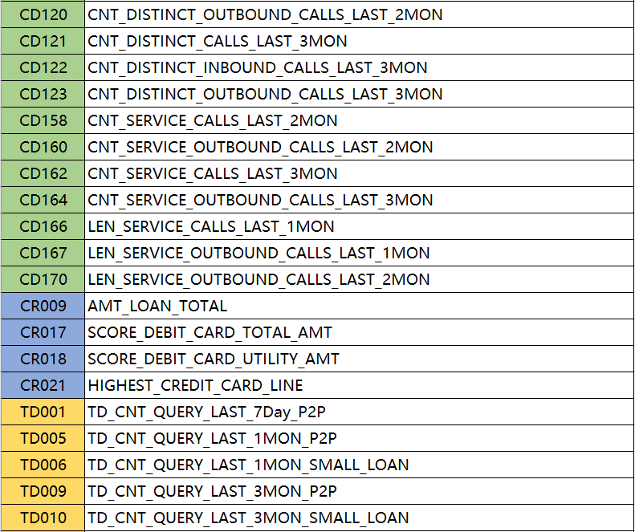
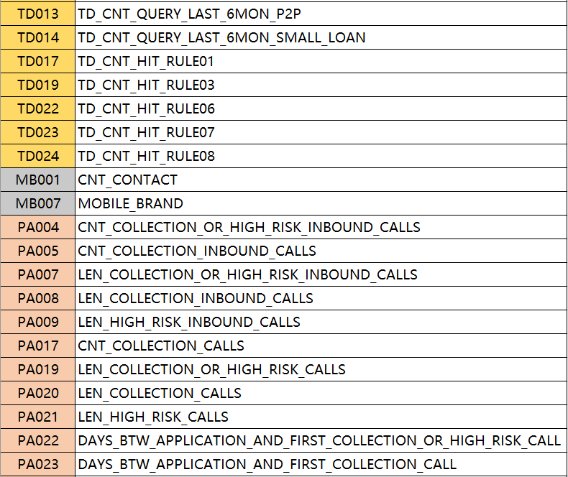
Variable Names

Slide 14
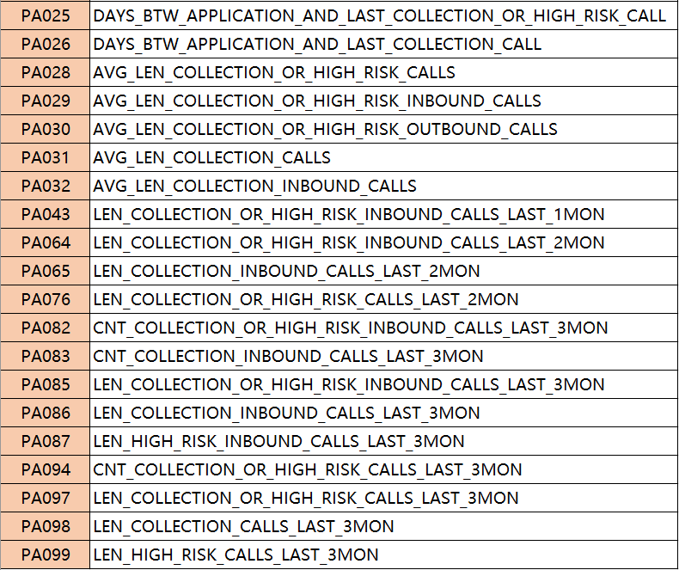
Variable Names

